Slide 1
Working with users and Groups

Slide 2
Manage users and group
Linux user accounts
Linux groups

Slide 3
How Linux User Accounts Work
Username
Password
By default, all user home directories are created and maintained in the /home
  directory.
However, the root user’s home directory is /root

Slide 4
Local option
/etc/passwd This file contains the user account information for your system.
/etc/shadow This file contains passwords for your user accounts.
/etc/group This file contains your system’s groups.

Slide 5
- The /etc/passwd File
Username:Password:UID:GID:Full_Name:Home_Directory:Default_Shell
Username: The Username field simply identifies the username the user will supply when logging in to the system
Password: This is a legacy field. At one time, the user’s password was stored in encrypted form in this field in the passwd file. However, for security reasons, the password has been moved from /etc/passwd to /etc/shadow.

Slide 6
UID This is the user ID for the user account
GID This field references the group ID number of the user’s default group
Full_Name This field contains the user’s full name
Home_Directory This field contains the path to the user’s home directory.
Default_Shell This field specifies the shell that will be used by default

Slide 7
- The /etc/shadow File
Username:Password:Last_Modified:Min_Days:Max_Days:Days_Warn:Disabled_Days:Expire
Username This is the user’s login name from /etc/passwd.
Password This is the user’s password in encrypted format
Last_Modified This field displays the number of days since January 1, 1970 that the password was last changed

Slide 8
Min_Days This field displays the minimum number of days required before a password can be changed. In this example, it is set to 0 days.
Max_Days This field displays the maximum number of days before a password must be changed. In this example, it is set to 99999 days. Effectively, this means a password isn’t required.
Days_Warn This field displays the number of days prior to password expiration that the user will be warned of the pending expiration. In this case, it’s set to 7 days.

Slide 9
Disabled_Days This field displays the number of days to wait after a password has expired to disable the account.
Expire (T/g hết hạn) This field displays the number of days since January 1, 1970 after which the account will be disabled. In this example, it is set to a null value, indicating the account never expires.

Slide 10
Creating and Managing User Accounts from the Command Line
Using useradd
Using passwd
Using usermod
Using userdel

Slide 11
- Using useradd
  Syntax: useradd options username
  ex (options default): useradd ncth
  ncth account is created using the default parameters contained in the following configuration files: /etc/default/useradd
  This file contains values that can be used for the GID and UID parameters when creating an account with useradd. It also contains
  defaults for creating passwords in /etc/shadow.

Slide 12
You can also view these default values by entering useradd –D at the shell prompt.
  Options
  –c Includes the user’s full name.
  –e Specifies the date when the user account will be disabled. Format the date as yyyy-mm-dd.
  –f Specifies the number of days after password expiration before the account is disabled. Use a value of –1 to disable this functionality, e.g., useradd –f –1 jmcarthur.
  –g Specifies the user’s default group.

Slide 13
  –G Specifies additional groups that the user is to be made a member of.
  –M Specifies that the user account be created without a home directory.
  –m Specifies the user’s home directory.
  –n Used only on Red Hat or Fedora systems. By default, these systems create a new group with the same name as the user every time an account is created. Using this option will turn off this functionality.
  –p Specifies the user’s password.

Slide 14
  –r Specifies that the user being created is a system user.
  –s Specifies the default shell for the user.
  –u Manually specifies a UID for the user.
  EX: useradd –c “Tommy” ncth1

Slide 15
- Using passwd
  The passwd utility is used to change an existing user’s password
  You can find out this information using the –S option with passwd. For example, we could enter passwd –S vmk at the shell promp
  Syntax: passwd username

Slide 16
options
  –l Locks the user’s account. This option invalidates the user’s password.
  –u Unlocks a user’s account.
  –d Removes a user’s password.
  –n Sets the minimum number of days required before a password can be changed.
  –x Sets the maximum number of days before a password must be changed.

Slide 17
  –w Sets the number of days prior to password expiration when the user will be warned of the pending expiration.
  –i Sets the number of days to wait after a password has expired to disable the account.

Slide 18
- Using usermod
From time to time, you will need to modify an existing user account. The syntax for usermod is very similar to that used by useradd.
Syntax:
usermod options username

Slide 19
options
–c Edits the user’s full name.
–e Sets the date when the user account will be disabled. Format the date as yyyy-mm-dd.
–g Sets the user’s default group.
–G Specifies additional groups that the user is to be made a member of.
–l Changes the username.
usermod –l newname existing

Slide 20
options
–L Locks the user’s account. This option invalidates the user’s password.
usermod –L username
–m moves the content of the default directory to new directory
usermod –md /home/dir username
–U Unlocks a user’s account that has been locked.
usermod –U username

Slide 21
options
–p Sets the user’s password.
–s Specifies the default shell for the user.
–u Sets the UID for the user.

Slide 22
Usermod Command
create a user named rhstudent with default properties.
useradd rhstudent
passwd rhstudent
grep rhstudent /etc/passwd
grep rhstudent /etc/group
grep rhtudent /etc/gshadow
grep rhstudent /etc/shadow
ls –dl /home/rhstudent

Slide 23
- Using userdel
It’s important to note that, by default, userdel will not remove the user’s home directory from the file system. If you do want to remove the home directory when you delete the user, you need to use the –r option in the command line.
For example, entering userdel –r ncth will remove the account and delete her home directory.

Slide 24
- Using userdel
Syntax:
userdel username
ex: userdel ncth

Slide 25
Linux Groups
How Linux groups work
Managing groups from the command line

Slide 26
How Linux Groups Work
If your Linux system has been configured to use local authentication, your groups are defined in the /etc/group file. Each record is composed of the following four fields:
Group:Password:GID:Users
Group Specifies the name of the group. In the example above, the name of the group is video.
Password Specifies the group password.

Slide 27
GID Specifies the group ID (GID) number of the group.
Users Lists the members of the group.
As with /etc/shadow, each line in /etc/gshadow represents a record for a single group. Each record is composed of the following fields: Group_Name:Password:Group_Admins:Group_Members

Slide 28
Managing groups from the command line
Using groupadd
Using groupmod
Using groupdel

Slide 29
- Using groupadd
Syntax:
groupadd options groupname
Options:
–g Specifies a GID for the new group.
–p Specifies a password for the group.
–r Specifies that the group being created is a system group.

Slide 30
- Using groupmod
To modify a group, including adding users to the group membership, you use the groupmod utility.
Syntax:
groupmod options group
Options:
–g Changes the group’s GID number.
–p Changes the group’s password.
–A Adds a user account to the group.
–R Removes a user account from the group.

Slide 31
If we wanted to add user ncth to the group, we would enter
groupmod –A ncth student
at the shell prompt.

Slide 32
- Using groupdel
Syntax:
groupdel group_name
ex: groupdel student

Slide 33
chage
derived from the words “Change Age”
It is used to modify the information such as duration when to change password
make account status active or inactive, sets expiry date of the account, and sets a reminder to change the password through an alarm before user’s account will be inactive.

Slide 34
chage
Chage [options..] User_Login_Name
1. Display Current Expiry Information
To display the complete statistics of changing account information, use the “-l” option.
chage -l [user_name]

Slide 35
chage
2. Change Current password Expiry Date
To modify the current password expiry date status, use the “-d” option.
$ chage -d 2022-08-29 fan
usermod –e 2022-08-29 fan

Slide 36
chage
3. Lock an Account: set expiry
The “chage” command allows you to set a duration to lock the user’s account where it will no longer remain
chage -E 2022-09-01 fan
Account expiry date updated

Slide 37
chage
4. Maximum Number of Days to Change Password
Use the “-M” command to set the duration of a maximum number of days in which the password can be changed.
sudo chage -M 10 fan

Slide 38
chage
5. Limit to Change Password After Expire
The “chage” command supports the option which allows you to change the password after its expiry date
sudo chage -I 10 fan
6. Display Help
$ chage -h

Slide 39
Create Groups
Create one user: rhstudent
Create five dummy groups,
groupadd dummygroup1
groupadd dummygroup2
groupadd dummygroup3
groupadd dummygroup4
groupadd dummygroup5

Slide 40
Create Groups
Add user in first three groups. Use –G option to add user in groups.
usermod –G dummygroup1, dummygroup2, dummygroup3 rhstudent
Verify that user is added in supplied group.
grep rhstudent /etc/group

Slide 41
Create Groups
Now add same user in remaining two groups.
usermod –G dummygroup4, dummygroup5 rhstudent
Check user’s secondary groups again.
grep rhstudent /etc/group

Slide 42
Create Groups
when we used usermod command again to add user in remaining groups, user was added in new groups but at the same time it was removed from all existing groups

Slide 43
Create Groups
Now let’s add user again in the remaining groups, but this time use –a option along with -G option.
usermod –aG dummygroup1, dummygroup2, dummygroup3 rhstudent

Slide 44


Slide 45
Create Groups
Groups are used to organize and administer user accounts.
The primary purpose of groups is to define a set of privileges such as reading, writing, or executing permission for a given resource that can be shared among the users within the group.
groupadd [OPTIONS] GROUPNAME

Slide 46
Create Groups
Only the root or a user with sudo privileges can create new groups.
When invoked, groupadd creates a new group using the options specified on the command line plus the default values specified in the /etc/login.defs file.

Slide 47
Create Groups
groupadd mygroup
The command adds an entry for the new group to the /etc/group and /etc/gshadow files.

Slide 48
Create Groups
If the group with the same name already exist, the system will print an error message like the following:
groupadd: group 'mygroup' already exists
To suppress the error message if the group exist and to make the command exit successfully, use the -f (--force)
groupadd -f mygroup

Slide 49
Create Groups
create a group named mygroup with GID of 1010 you would type:
groupadd -g 1010 mygroup
verify the group’s GID, by listing all groups and filtering the result with grep :
getent group | grep mygroup

Slide 50
Create Groups
If a group with the given GID already exist, you will get the following error:
groupadd: GID '1010' already exists

Slide 51
groupadd
1. groupadd lpu
Usermod –aG lpu user1
//-a append and –G specifies the additional group user is to be made member of.
2. lid -g lpu //display user’s group and group’s user
// -g sets user’s default group
3. gpasswd –d username groupname
// used to delete a user from specific group. Other users remain part of group only that specific user is deleted.
4. Useradd –g groupname username

Slide 52
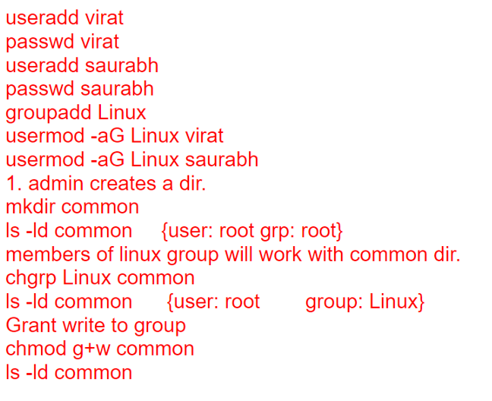
Sticky bit

Slide 53
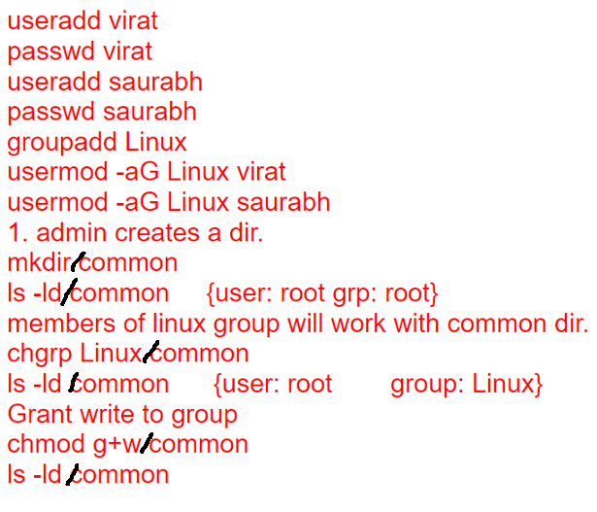
Sticky bit

Slide 54
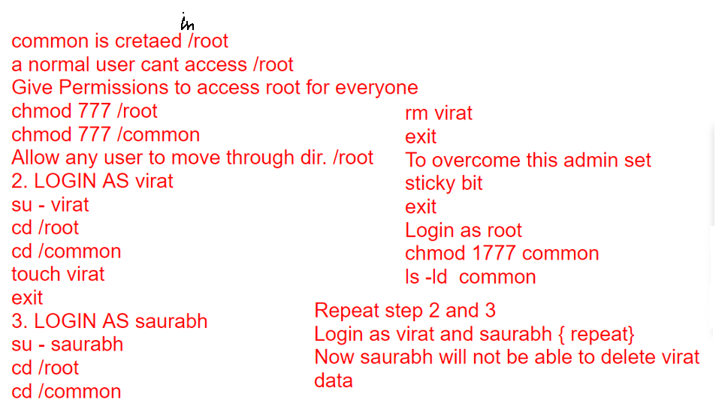
Sticky bit

Slide 55
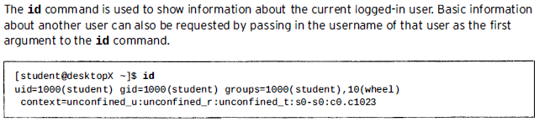
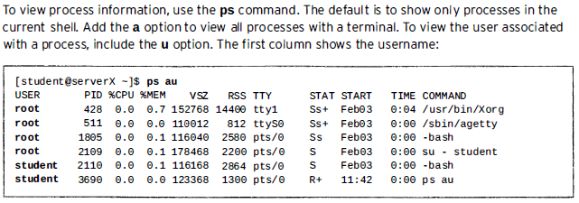
user

Slide 56
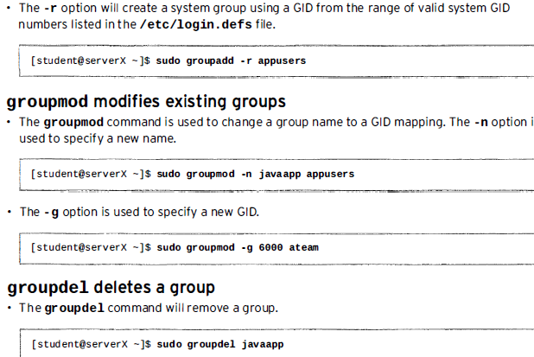
group

Slide 57
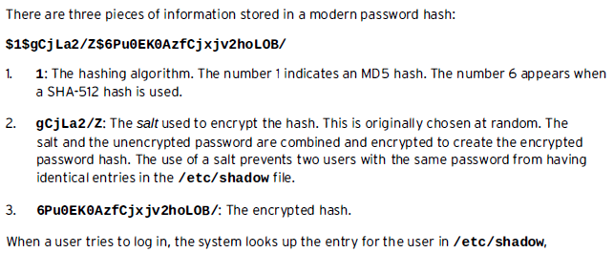
User password

Slide 58
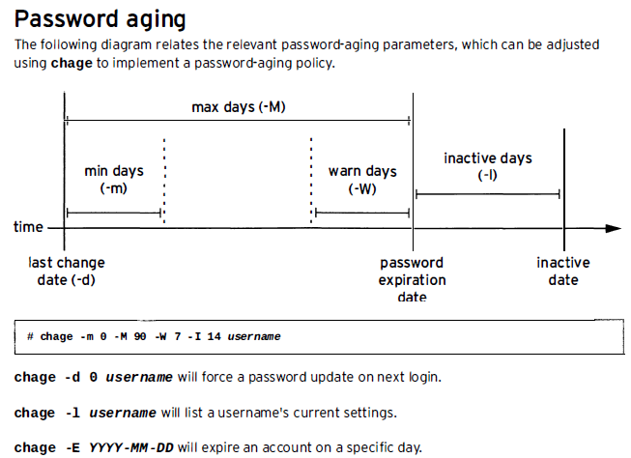
User password

Slide 59
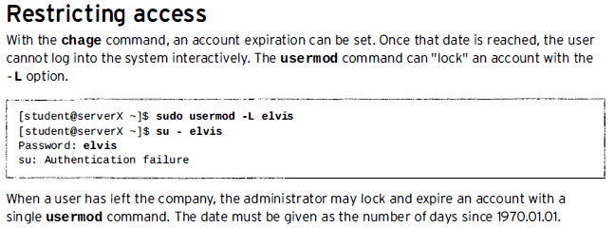
User password

Slide 60
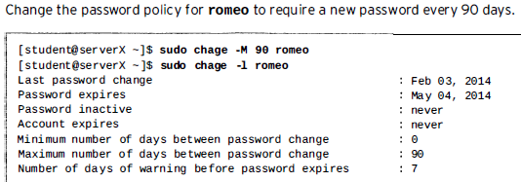
User password

Slide 61
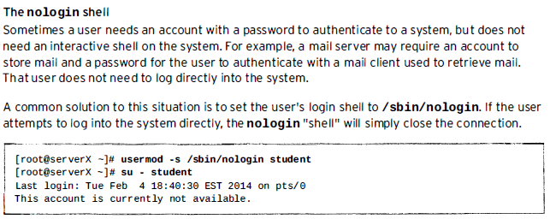
User password

